Slide 1
Lecture 4 UNGUIDED TRANSMISSION
Introduction
In unguided transmission:
no wires or cables used to the signal
but there is always some means for the signal to propagate from one end to the other.
Unguided transmission is popularly known as wireless.
Transmissions and receptions are achieved by means of an antenna and can be:
Directional
Omnidirectional
Directional or point-to- point transmission is line of sight transmission:
Because of this the distance between stations is limited depending on the local geographical area. The line of sight

Slide 2
The line of sight due to the Earth's curvature is limited 50 km to the horizon.
Repeater stations must be placed after every 50km to boost data signal.

Slide 3
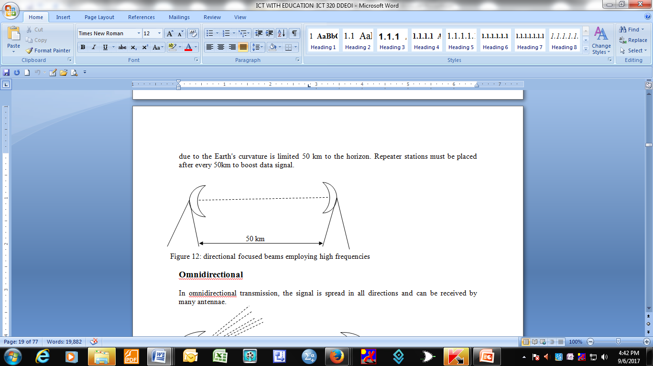

Slide 4
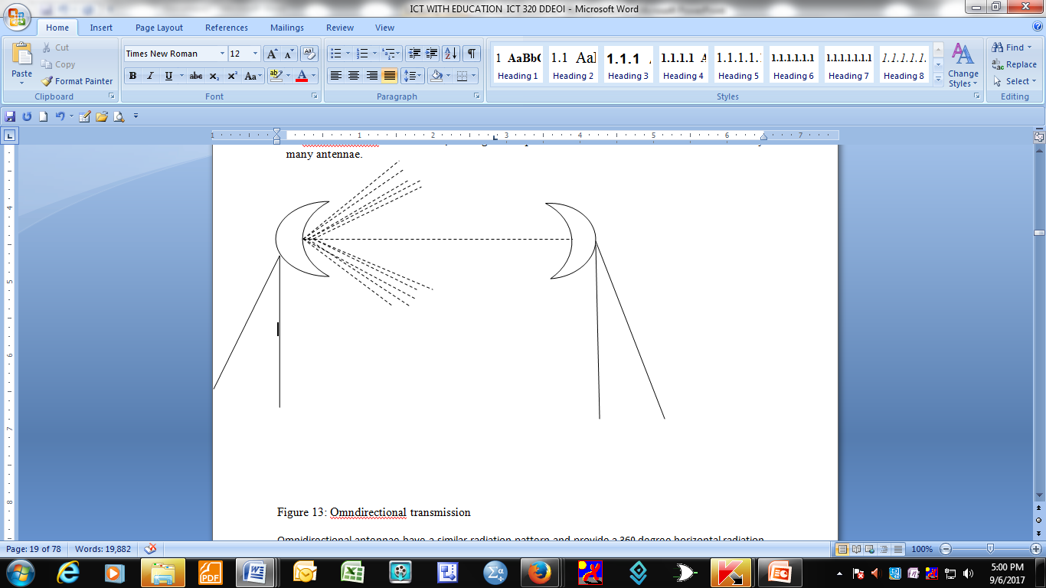
Omnidirectional
signal is spread in all directions
can be received by many antennae
Ominidirectional transmission

Slide 5
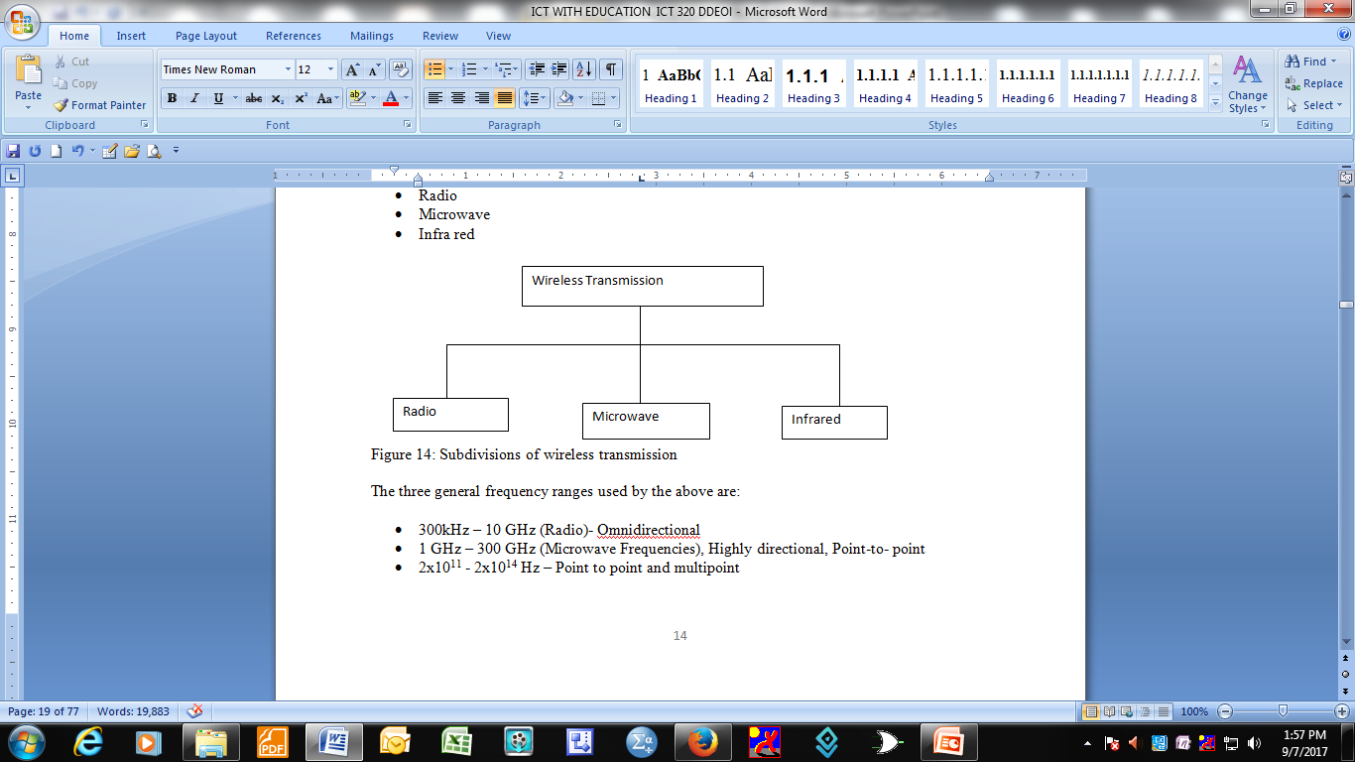
Subdivisions of wireless transmission
Unguided/wireless transmission can be classified under:
Radio
Microwave

Slide 6
The three general frequency ranges used by the above are:
300kHz – 10 GHz (Radio)- Omnidirectional
1 GHz – 300 GHz (Microwave Frequencies), Highly directional, Point-to- point
2x10¹¹ - 2x10¹⁴ Hz – Point to point and multipoint

Slide 7
Radio Frequencies
Radio Frequencies are in the range of 300 kHz to 10 GHz
Wireless LANs use this range of frequencies. They are also used for radio broadcast.
Some LANs use radio frequencies to connect the workstations together although some also use infrared technology.

Slide 8
Microwave
microwave transmission is line of sight transmission.
The transmitting antenna and the receiving antenna must be in visible contact with each other
This means that the antennae must be placed on high ground, roof tops or on top of mountains to prevent any signal obstructions.

Slide 9
Infrared
is a wireless transmission media that sends signals using infrared light waves.
Infrared transmission requires a line of sight transmission i.e. the sender and receiver must be aligned so that nothing obstructs the path of infrared light wave.

Slide 10
Terrestrial Micro wave Transmission
Uses a parabolic dish to transmit and receive signals.
The typical size of the dish is 3 metres in diameter.
The antenna is fixed rigidly and focuses on a narrow beam to achieve line-of-sight transmission to the receiving antenna.
The antenna is usually located at substantial heights above the ground to be able to transmit over intervening obstacles.
For long distance transmission, a series of micro wave relay towers are used and point – to – point micro wave links are strung together over the desired distance (see figure 15 below).

Slide 11
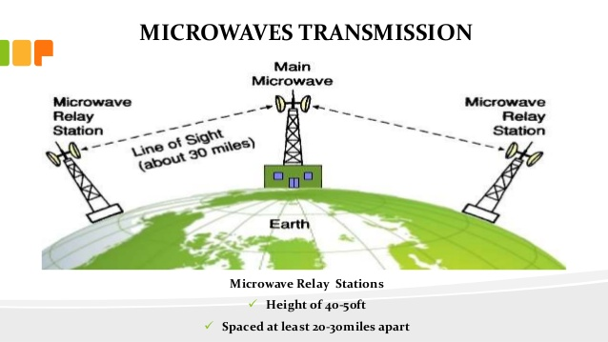

Slide 12
Primary use is long haul telecommunication services.
Micro wave transmission is commonly used for :
voice
television transmissions
as well as in cellular systems.

Slide 13
Transmission characteristics
Common frequencies used for transmission is in the range of 1 to 40 GHz.
The higher the frequency used, the higher the potential bandwidth and the higher the potential data transfer rates
The main source of signal loss is attenuation.
For micro wave (and radio frequencies), the loss due to attenuation can be expressed using the formula:
d is the distance and ƛ is the wavelength, in the same units. From the formula it is clear that loss due to attenuation varies as the square of the distance

Slide 14
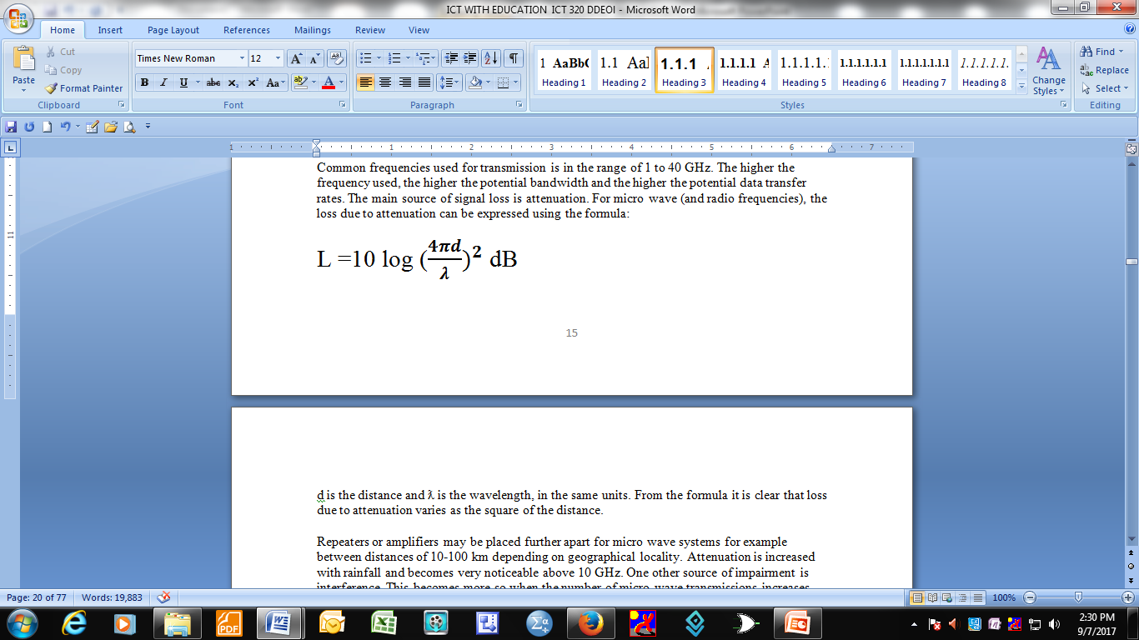
For micro wave (and radio frequencies), the loss due to attenuation can be expressed using the formula:
d is the distance and ƛ is the wavelength, in the same units. From the formula it is clear that loss due to attenuation varies as the square of the distance.

Slide 15
Repeaters or amplifiers may be placed further apart for micro wave systems for example between distances of 10-100 km depending on geographical locality
Attenuation is increased with rainfall and becomes very noticeable above 10 GHz.
One other source of impairment is interference. This becomes more so when the number of micro wave transmissions increases, since there is an overlap in the transmission areas and interferences becomes a real danger.
To minimize interference, the assignment of frequency bands is strictly regulated. The most common bands for long haul telecommunications are 4 GHz – 6 GHz.

Slide 16
Satellite Transmission
Satellite transmission makes it possible to relay the signal around the curve of the Earth.
This in turn allows communication between widely separated points.
Communications satellites use a wide range of radio and microwave frequencies and to avoid signal interference, international organizations have regulations for which frequency ranges or "bands" certain organizations are allowed to use.

Slide 17
Types of satellites
Communications satellites are classified into three broad categories depending on their distance from the earth:
Geostationary Earth Orbit (GEO) Altitude – 35785 ≈ 36,000 km
Medium Earth Orbit (MEO) Altitude – 8000 – 18,000 km
Low Earth Orbit (LEO) – Altitude up to 200 km

Slide 18
Geostationary Earth Orbit (GEO)
The GEO satellites are positioned at 35,785 km or 22,236 miles above the earth and above the equator.
At this position the earth’s force of gravity is cancelled by the centrifugal force of the rotating universe.
This distance is approximately one tenth of the distance to the moon. At position, for one to understand how far this is, calculate the time for a round trip of a radio signal travelling at the speed of light (3 x 10⁸ metres per second).
Time for round trip = 2 x 35.8 x 10⁶ metres / 3 x 10⁶ metres = 0.238 sec

Slide 19
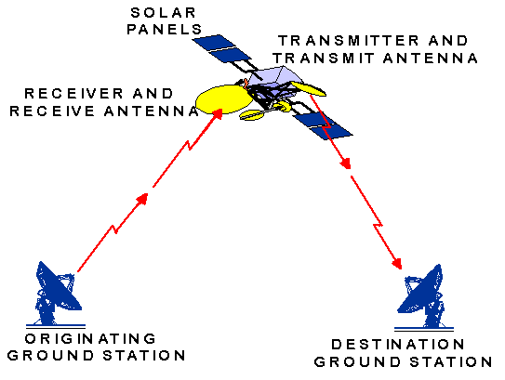
Time for round trip = 2 x 35.8 x 10⁶ metres / 3 x 10⁶ metres = 0.238 sec

Slide 20
Components of a GEO satellite and their functions
A GEO satellite has the following components:
Communications system: - this includes antennas and transponders that receive and re- transmit signals
Power system: - this includes solar panels that provide power
Propulsion system: - includes the rockets that propel the satellite. A satellite needs its own propulsion system to get itself to the right orbital location and to make occasional corrections to that position. This is because a satellite in geostationary orbit can deviate up to a degree every year from north to south or east to west of its location because of the gravitational pull of the moon and sun. Satellite operation life span is determined by the amount of fuel it has to power thrusters which are used to maintain the satellite’s orbital position. When the fuel runs out, the satellite drifts into space and out of operation and becomes space debris. The satellite needs internal power to be able to operate its electronic systems and communication payload. Main source of power is sunlight which is harnessed by the satellite solar panels.

Slide 21
Batteries: - these are used to provide power to the satellite when the sun is blocked by the earth. The batteries are charged by the excess current generated by the solar panels when there is sunlight.
Thermal system:- used protect sensitive electronic and mechanical components from extreme changes in temperature by activating cooling mechanisms when its gets too hot or heating systems when it gets too cold (Comer, 2009).

Slide 22
GEO coverage of the earth
limited amount of space available in the geosynchronous orbit above the equator
limits the number of GEO satellite that can be used to cover the earth.
reason for this is that communication satellite using a given frequency must be separated from one another to avoid interference.
minimum separation depends on the power of the transmitters but may require angular separation of between 4 and 8 degrees.
the entire 360 degree circle above the equator can only hold 45 to 90 satellites.
minimum number of GEO satellites to cover the earth is three (3). If the satellites are positioned around the equator with 120 degrees then 360/120 = 3. (See figure below)

Slide 23
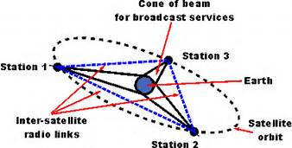

Slide 24
Advantages and disadvantages of GEO
High data transfer rates because of high bandwidth
Cost is independent of distance
Coverage area exceeds terrestrial systems
Satellite to satellite communication is very precise

Slide 25
Disadvantages
Propagation delays and weak signals
Expensive to implement and launch. The cost depend on distance and weight
GEO satellite, centred above the equator have difficulty broadcasting signals near polar regions
Affected by snow and rain

Slide 26
Low Earth Orbit (LEO)
Leo is the primary alternative to GEO.
The altitudes are up to 200 km and they use a general technique known as clustering or array deployment.
A group of Leo’s are designed to work together and members of a group stay in communication and agree to send messages as agreed.

Slide 27
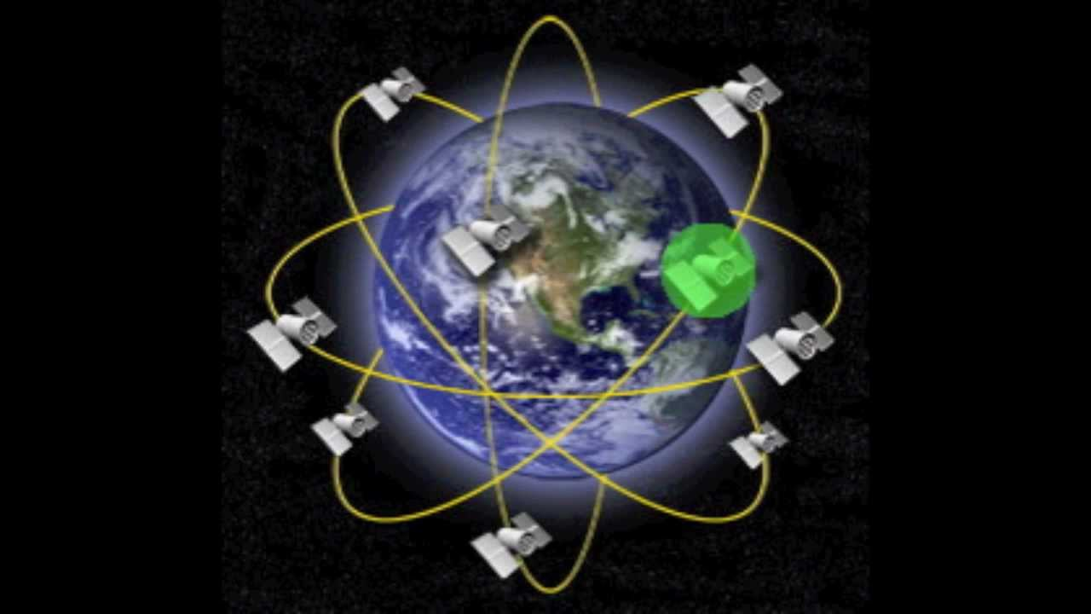

Slide 28
MEO is an orbit that lies between 8000 and 18000 k m above the earth’s surface. These satellites are similar to LEO in terms of functionality and a visible for much longer periods compared to LEO and have a larger coverage area.

Slide 29
Medium Earth Orbit (MEO)
Most communication applications use LEO satellites because it takes less energy to place the satellites into LEO and they use less powerful amplifiers for successful transmission.
Advantages of LEO
They have better signal strength compared to GEO
- There is less time delay and this makes it better for point to point communication
- There have a smaller area of coverage compared to GEO, so there is less wastage of bandwidth
Disadvantages of LEO
- A network of Leo of LEO satellites is needed which can be costly
transmitting or receiving data from low earth orbit (LEO) satellites requires correcting the frequency in response to the motion of the satellite with respect to the observer (Doppler shift).
(- an apparent shift in frequency for a sound wave produced by a moving source)

Slide 30
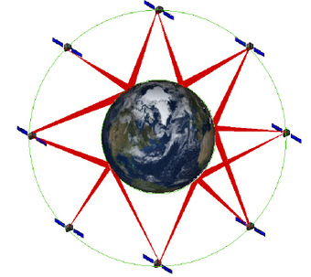

Slide 31
Advantages of MEO
Longer duration of visibility and a wide footprint
Maintains a footprint suitable for regional networks
Disadvantages
Longer time delay compared to LEO
Weaker signal compared to LEO

